Slide 1





What Are MFA ?
It is more than a password multi-factor authentication (MFA) is a multi-step account login process that requires users to enter more information than just a password Combines at least two factors knowledge (password), possession (phone), or inherence (fingerprint).
Standard practice in securing enterprise and consumer accounts.
Types of MFA prevalent in enterprises
Text message – SMS
Application-based
(TOTP, Push Notifications)
Hardware tokens or keys
(Yubikey, etc.)

Slide 2

How SIM Swapping Attack is Performed
Definition
A type of attack where the victim’s phone number is transferred to a SIM card controlled by the attacker, allowing them to intercept SMS-based MFA codes.
Steps
Social Engineering: The attacker gathers the victim’s personal information (e.g., name, address, or phone number).
Contact Telecom Provider: The attacker impersonates the victim and requests a SIM swap.
Intercept MFA Codes: The attacker uses the victim’s phone number to intercept one-time passcodes.
Account Takeover: Access to the victim's accounts is achieved.
Target Primarily individuals, often for bank account or email fraud.
Complexity Medium; requires persistence and social engineering skills.
Impact Loss of sensitive data, financial fraud, and unauthorized account access.

Slide 3




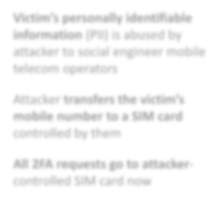
SIM
Swapping Attack
Step 2a: Social engineering.
Mobile operators/ telecommunications approached.
Major Target: Consumer Complexity: Medium Prevalence: Low
Step 1: Social engineering
Get initial victim information
Step 2b: Mobile operators/ telecommunications falls for it
initiates SIM swap
Victim’s personally identifiable information (PII) is abused by attacker to social engineer mobile telecom operators
Attacker transfers the victim’s mobile number to a SIM card controlled by them
All 2FA requests go to attacker- controlled SIM card now
Step 5: Account take over successful
Step 4: Victim attempts to authenticate
MFA code goes to the attacker
Step 3: Attacker sends Phishing link to the victim

Slide 4

How Social Engineering Attack is Performed
Definition
Manipulating individuals into divulging confidential information or taking actions that compromise their security.
Steps:
Fake Communication: Attackers send phishing emails, texts, or make calls pretending to be legitimate entities (e.g., banks or IT teams).
Credential Phishing: Victims are tricked into entering usernames, passwords, or MFA codes on fake websites.
Real-Time Credential Theft: Attackers use credentials immediately to access accounts.
Account Takeover: Stolen credentials allow attackers to bypass authentication measures.
Target Consumers and enterprises.
Complexity Low exploits human error and trust.
Impact Enables attackers to access sensitive systems, conduct financial fraud, or compromise organizational networks.

Slide 5
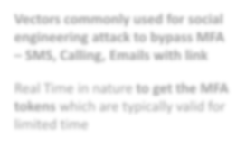


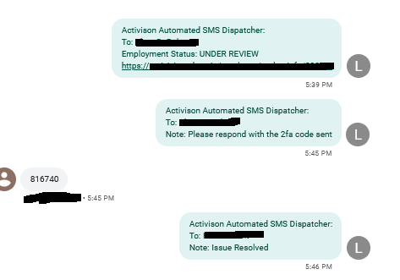
1st Authentication
2nd Authentication
Victim
Fake Session
Social Engineering Attack
Major Target: Consumer/Enterprise
Complexity: Low
Prevalence: Medium
Step 4: Victim receives real 2FA
Step 5: Vitim enters real 2FA code into fake 2FA page
Fake Page
Step 1: Victim enters credentials
This is done on a phishing page
Step 2: Credentials relayed to attacker
Using real-time messaging
Step 6: Real 2FA code relayed to attacker
Vectors commonly used for social engineering attack to bypass MFA – SMS, Calling, Emails with link
Attacker
Real Session
Attacker
Attacker
Real Time in nature to get the MFA tokens which are typically valid for limited time
Step 7: Attacker enters real “Phished” 2FA code into real page
Step 3: Attacker enters
Real two-factor Authentication
Successful Authorization
obtained credentials
Attacker enters credentials into the target site
Target Site
Page
Step 8: Account takeover successful
Credit:@vx_underground

Slide 6
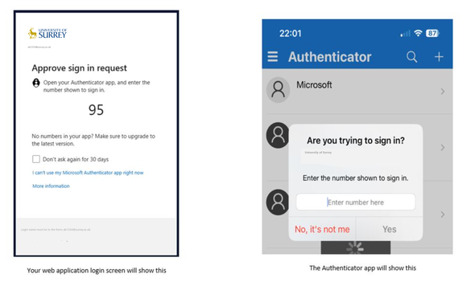

How MFA Fatigue Attacks is Performed
Definition:
A tactic where attackers overwhelm a victim with repeated MFA push notifications until they accept one, granting unauthorized access.
Steps:
Credential Theft: Attackers obtain login credentials (e.g., through phishing or brute force).
Initiate MFA Requests: A large number of authentication prompts are sent to the victim’s device.
Fatigue and Error: Victims, frustrated by the bombardment, approve one of the requests.
Account Takeover: Attackers gain full access to the victim’s account.
Target: Enterprises; commonly exploited by advanced threat actors like APT29.
Complexity: Medium; relies on human behavior rather than technical vulnerabilities.
Impact: Responsible for high-profile enterprise breaches, leading to data theft or lateral movement within networks.

Slide 7








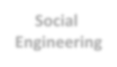
Step 1: Attacker logs in with phished credentials
MFA fatigue attacks
Major Target: Enterprise Complexity: Medium Prevalence: Medium/high
Attacker
Target Site
Attacker Continue Spamming
?
First level authentication successful
NO
YES
Initiate MFA Push
Step 2+: Infinite push MFA notifications sent to victim’s phone
Spam push notifications to users’ device
User might accept push notification
as a result of MFA fatigue
Victim’s Phone
Sometimes MFA fatigue is combined with social engineering methods
NO
Attacker
Attack type increasing in popularity.
Used by APT groups like APT29
Victim Accept MFA
Push?
YES
Multiple recent high-profile enterprise breaches were a result of MFA fatigue. Examples – Lapsus$, Yanluowang
Social Engineering
Attacker lured victim to accept MFA push notification through
Step 3: Account takeover successful
Social engineering

Slide 8
How Adversary-in-the-Middle (AiTM) Attack is Performed
Definition:
Attackers position themselves between the victim and the legitimate service to intercept login credentials and session cookies.
Steps:
Phishing Page: Victims are directed to a fake login page that mimics a real service.
Credential Relay: The attacker forwards credentials to the legitimate site in real time.
MFA Token Theft: The attacker intercepts MFA tokens and uses them to log in.
Session Persistence: Stolen session cookies allow attackers to bypass MFA for subsequent logins.
Target: Enterprises; particularly employees with high-level access.
Complexity: Medium; requires a proxy-based infrastructure.
Impact: Persistent access to enterprise systems, leading to sensitive data theft or espionage.

Slide 9





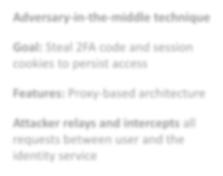


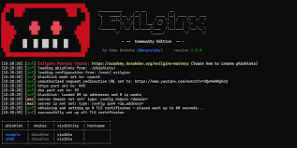


Victim
AiTM Infrastructure
Target Site
Adversary-in- the-middle (AITM)
Major Target: Enterprise Complexity: Medium Prevalence: Medium (increasing)
1
Log credentials
Enters the
credentials
Target Site
First authentication level success
2
Logs token
Target Site
Adversary-in-the-middle technique
Enters the
MFA token
Forwards
2FA request
MFA Login Screen
Goal: Steal 2FA code and session cookies to persist access
Features: Proxy-based architecture
2FA request
Forwards 2FA token
Attacker relays and intercepts all requests between user and the identity service
Authentication success
3
Logs session cookie
Target Site
Victim
Compromised
Redirect
user to portal
Session
Logged in To Legit Site
cookie sent
Malicious transparent proxy

Slide 10





What are Phishing kits
Phishing kits are pre-packaged tools that make it easy for attackers to create fake websites and steal sensitive information like passwords and MFA codes. They include templates mimicking real sites, automated tools for collecting data, and features to bypass security measures.
Enable real-time attacks by acting as a middleman (Adversary-in-the-Middle or AiTM).
These kits often come with anti-detection features to evade security systems and are widely accessible, either through open-source platforms or Phishing-as-a-Service (PhaaS).
They have made phishing campaigns easier and more effective, posing a significant cybersecurity threat.
Evilginx
Muraena
Modlishka

Slide 11


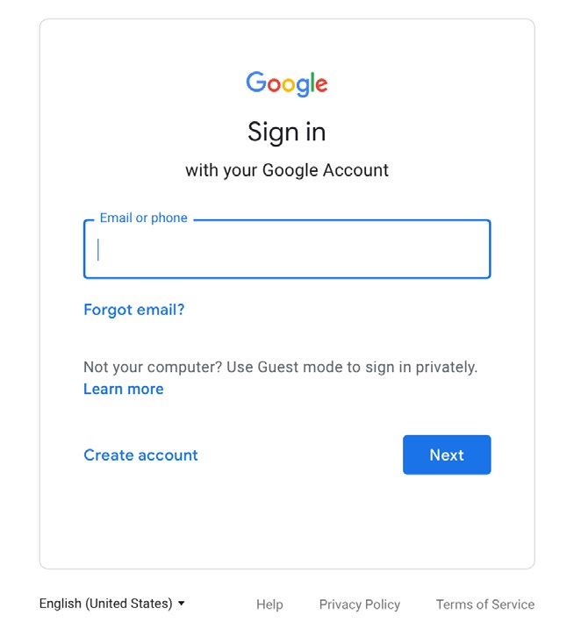

Real-World MFA Attacks
Adversary-in-the-Middle (AiTM) Attacks
Attacker intercepts communication between user and service.
Steals MFA codes and session cookies to maintain access.
Proxy-based architecture enables real-time credential relaying.
Open Redirect
Stage-2: Redirector
Email
Compromised Domain Redirector
Client Fingerprinting over WebSocket
Snapchat
Open Redirect
AiTM Gmail Phishing page

Slide 12


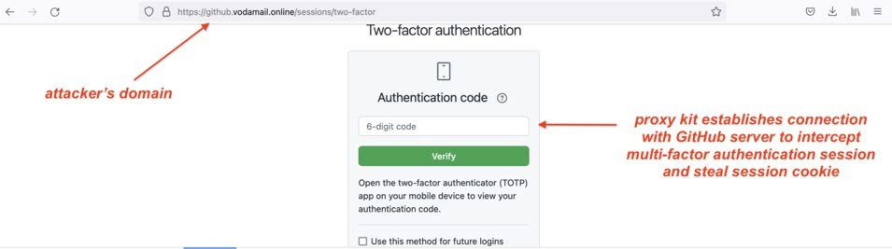

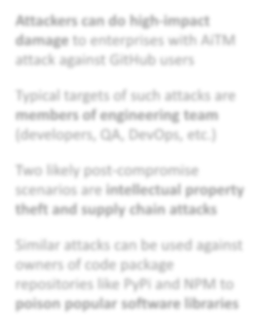



Attackers View After steeling victim’s session cookie
AiTM attack against code repositories
Major Target: Consumer/Enterprise
Complexity: Low
Prevalence: Medium
Step 1: Logs in using session cookie stolen with AiTM
Attacker
GitHub Login Page
Attackers can do high-impact damage to enterprises with AiTM attack against GitHub users
Step 2a: exports
Step 2b: inject malicious code to GitHub repository
GitHub repository
Typical targets of such attacks are members of engineering team
Two likely post-compromise scenarios are intellectual property theft and supply chain attacks
Step 3a: Uploads to attacker’s server
Step 3b: Malicious code propagates to all software dependencies
Attacker’s Server
Intellectual property theft
Supply chain attack scenario

Slide 13
AiTM Attack Against Code Repositories
Definition:
AiTM phishing techniques used to target developers and compromise code repositories like GitHub, PyPi, or NPM.
Steps:
Phishing Campaign: Victims are lured to fake login pages for repositories.
Session Cookie Theft: Attackers steal session cookies to gain access.
Post-Compromise Actions:
Scenario 1: Intellectual property theft (e.g., downloading private repositories).
Scenario 2: Supply chain attacks by injecting malicious code into repositories, propagating it to dependent software.
Target: Developers, QA engineers, and DevOps teams.
Complexity: Low to medium; highly effective.
Impact: Can lead to poisoned software libraries, impacting large-scale systems and organizations reliant on compromised software.

Slide 14


Impact of MFA Attacks on Enterprises
Intellectual Property Theft: Stealing codebases or proprietary data.
Lateral Propagation: Moving through internal systems to compromise other accounts.
Espionage: Gaining access to sensitive
organizational secrets.
Reputational Damage: Loss of customer trust
after breaches.
Intellectual Property theft
01
02
Lateral Propagation
03
Espionage
04
Brand Reputation
05
Internal Secrets

Slide 15

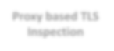



Defensive Strategies
Avoid SMS-based MFA: Vulnerable to SIM-swapping.
Use FIDO2-Based MFA: Secure, phishing-resistant.
In-line proxy based SSL/TLS inspection to detect the Phishing attacks
Security Training: Teach employees to recognize phishing attempts.
Phishing Simulations: Regular exercises to test and improve awareness.
Legitimate Service being Phished
Proxy based TLS Inspection
Threat Actor hosting AiTM phishing
Security Awareness Training
Phishing Simulation exercises
Victim Enterprise
Cautioning users at the time of attack
DO NOT provide your OTP code on this site or over SMS

Slide 16

Zero Trust Architecture
Definition
Zero Trust Architecture is a security framework that assumes no user or device should be trusted by default, regardless of location, and enforces strict identity verification for every access request.
Key Principles
Verify Explicitly
Continuously validate identities and devices using multifactor authentication (MFA), device posture, and other context data.
Least Privilege Access
Limit user access to the minimum resources needed to perform their tasks.
Assume Breach
Implement measures to contain the impact of potential security breaches, such as network segmentation and continuous monitoring.
Benefits
Minimized Attack Surface:
Applications and resources are hidden from unauthorized users.
Improved Data Protection:
Prevents unauthorized access and data exfiltration.
Resilience Against Modern Threats:
Mitigates risks like phishing, credential theft, and AiTM attacks.

Slide 17


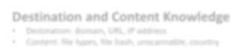



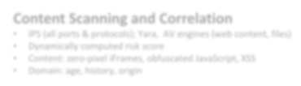





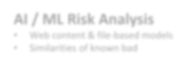




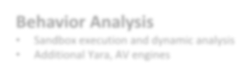






Zero Trust Architecture Secure applications without exposing networks
#RSAC
1 Prevent Compromise
Destination and Content Knowledge
Destination: domain, URL, IP address
Content: file types, file hash, unscannable, country
Minimizes the attack surface
Apps are invisible to the internet
Inline cyber threat protection
SSL / TLS at Scale
Content Scanning and Correlation
IPS (all ports & protocols); Yara, AV engines (web content, files)
Dynamically computed risk score
Content: zero-pixel iFrames, obfuscated JavaScript, XSS
Domain: age, history, origin
IaaS / PaaS
Data Center
AI / ML Risk Analysis
Web content & file-based models
Similarities of known bad
Data or Pixels (Browser Isolation)
Behavior Analysis
Sandbox execution and dynamic analysis
Additional Yara, AV engines
Active Defense
Uses decoys to catch attackers moving laterally on the network
2 Prevent Lateral Movement
Three Levels of Segmentation
Pixels
Browser Isolation
Stream pixels to the endpoint
Content Delivery Method
User to App
Workload to Workload
Identity-based Microsegmentation
Data or Pixel Stream (Browser Isolation)
User + Device | Workload | IoT/OT

Slide 18



Call To Action
Key Takeaways
Conventional MFA methods are no longer sufficient.
AiTM and PhaaS are rising threats.
Advanced security measures like FIDO2 and zero trust are essential.
Call to Action
“Review and strengthen your MFA strategies today!”
“Invest in training and technology to stay ahead of attackers.”

Slide 19
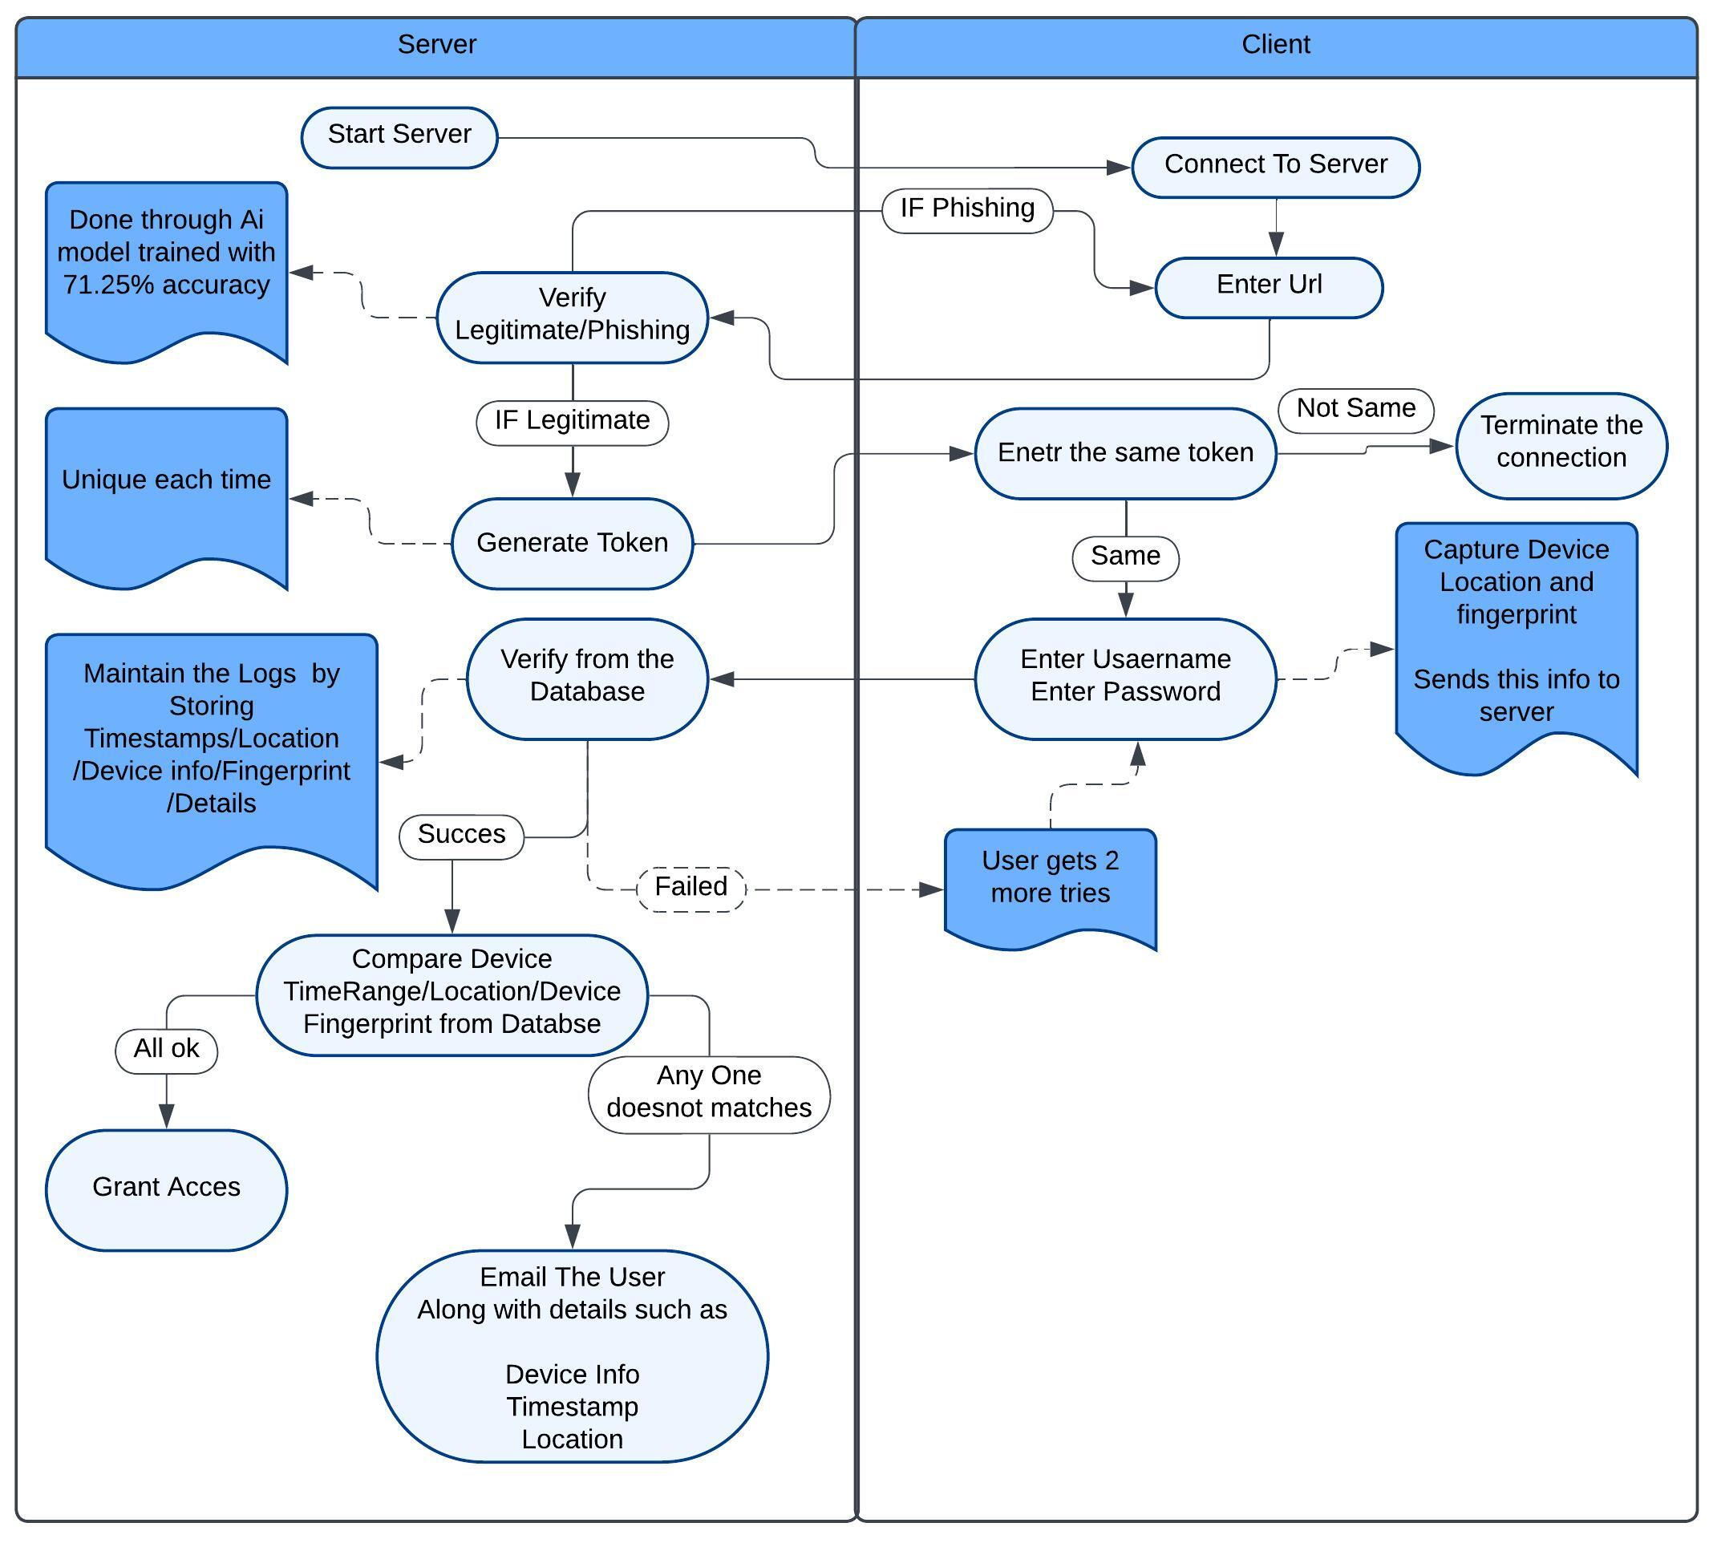
MFA Code Implementation
Python based Client Server Code Using:
socket
joblib
pandas
uuid
os
datetime
ssl
smtplib
csv
email.mime.multipart
email.mime.text

